Slide 1
Chapter 2 Arrays and Structures

Slide 2
2.1 Arrays
2.1.1 Abstract Data Type
2.1.2 Arrays in C

Slide 3
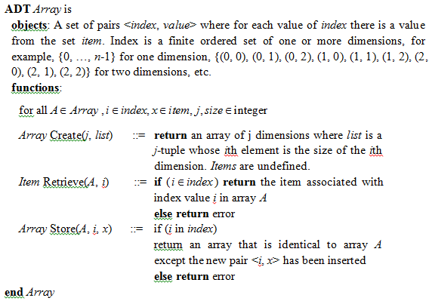
2.1.1 Abstract Data Type

Slide 4
2.1.2 Arrays in C
definition
Arrays and pointers
Address of Arrays

Slide 5
2.2 Dynamic Allocated Arrays
One-Dimensional Arrays
Two-Dimensional Arrays
  malloc
  calloc
  realloc

Slide 6
2.6 Representation of Multidimensional Arrays
Way 1: array-of-arrays
Way 2: map all elements into an ordered or linear list

Slide 7
2.3 Structures and Unions
2.3.1 Structures
2.3.2 Unions
2.3.3 Internal Implementation of Structures
2.3.4 Self-Referential Structures

Slide 8
2.3.1 Structures
struct {
char name[10];
int age;
float salary;
} person;
typedef struct {
char name[10];
int age;
float salary;
} person;
person person1, person2;
if (person1 == person2) {
//do something
}

Slide 9
2.3.2 Unions
Difference between structures and unions?

Slide 10
2.3.3 Internal implementation of Structures
Size of structures

Slide 11
2.3.4 Self-Referential Structures
typedef struct list {
char data;
list *link;
};

Slide 12
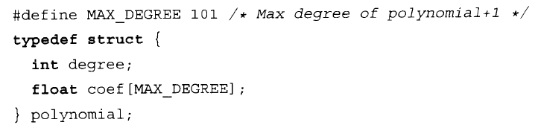
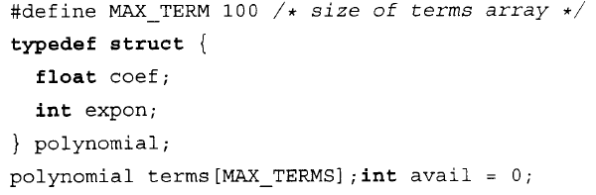
2.4 Polynomials

Slide 13
Polynomial calculations
Polynomial Add
Single Multiply
Multiply

Slide 14
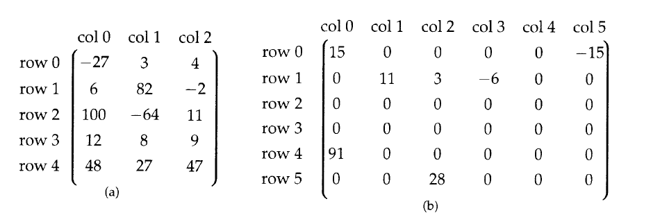
2.5 Sparse Matrices
Self-Reading

Slide 15
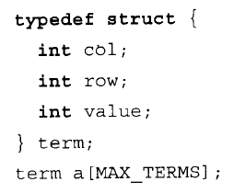
Representations

Slide 16
2.7 Strings
String length
常用函数
Pattern Matchin

Slide 17
Homework
Page 58 4
Page 64 2
Page 84 6
Page 98 4
Page 99 2

